Slide 1

Invasive Ductal Carcinoma Classifier API
Hassan Alnamer

Slide 2
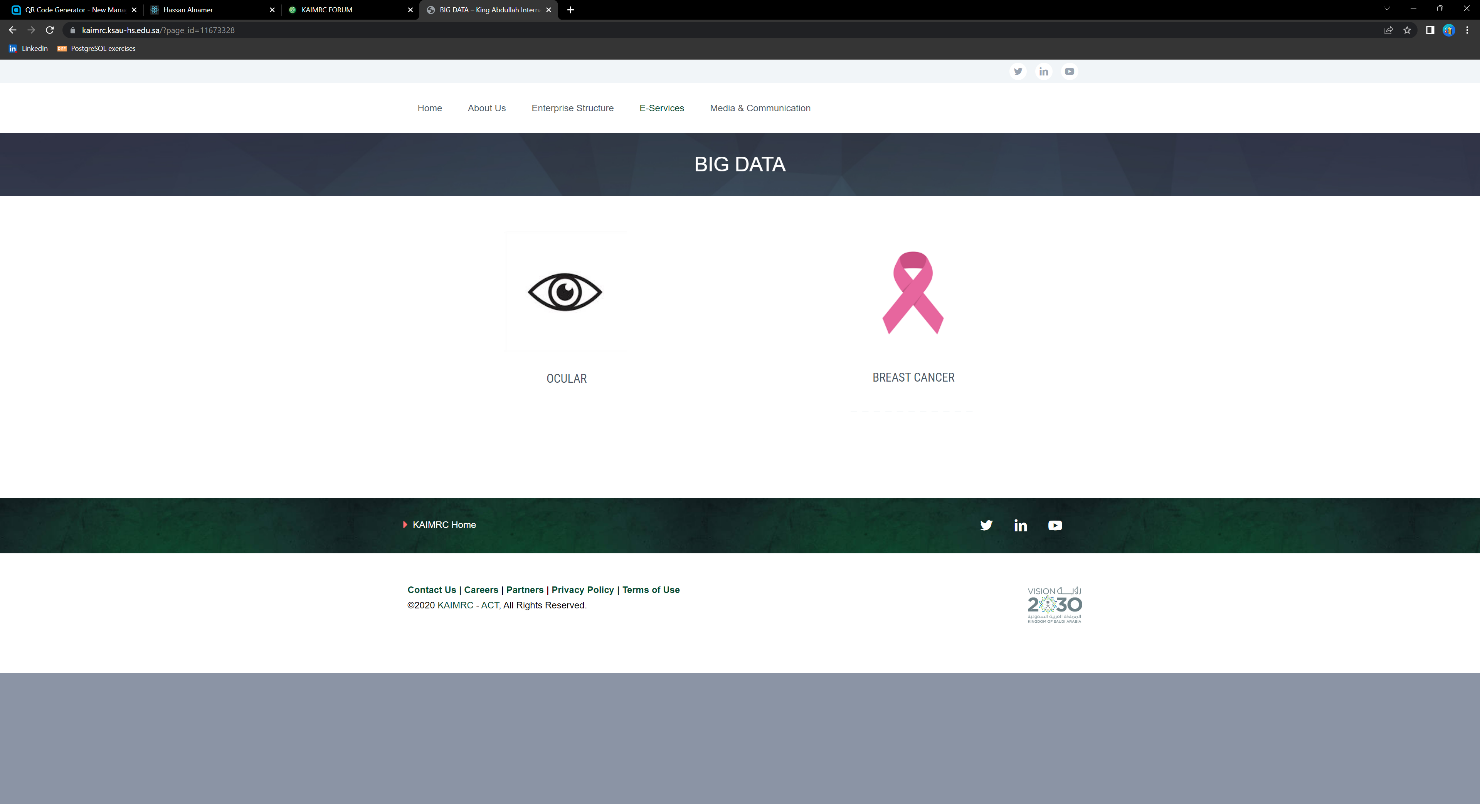
Motivation

Slide 3

Motivation

Slide 4
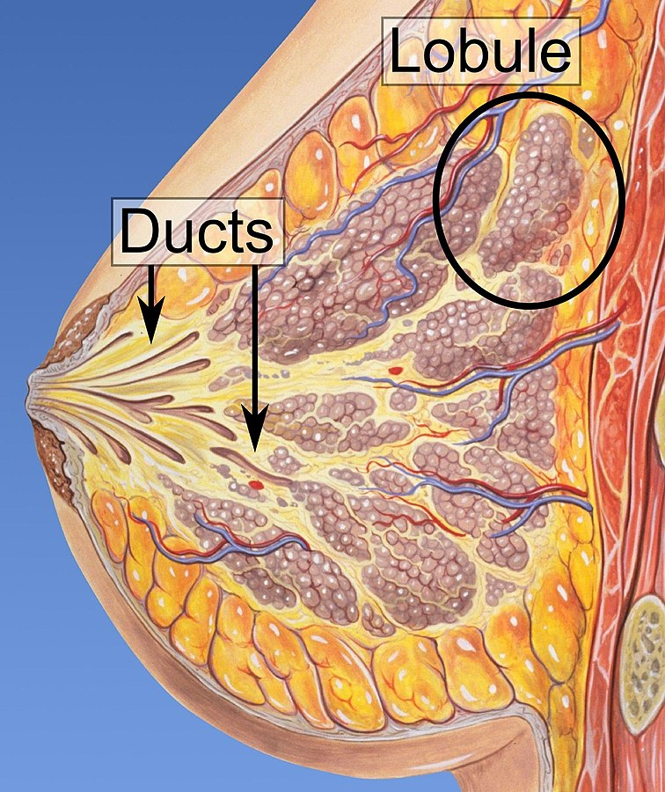
Motivation
Cells in the mammillary duct go crazy
Could spread around and form metastases
Can be diagnosed by taking a biopsy of the tissue
Pathologist will decide whether it is dangerous or not

Slide 5
Solution
Create an agile solution to help pathologists in their work
Docker Container
Flask API
ML model

Slide 6

Approach: Data Data Data
We can turn this to a computer vision problem
Found related data on Kaggle.
Based on pictures of 280 female patients
The data set has 280K biopsy pictures
280K Pictures
198K Negative diagnosis
78K Positive diagnosis

Slide 7

Approach: Model
To get a head start I used the following model that I found on Kaggle
The model uses resNet18 to extract 512 features
Then adds additional layers to compress them to 2
BatchNorm1D
Relu
Linear
Resnet18 (512 features)

Slide 8
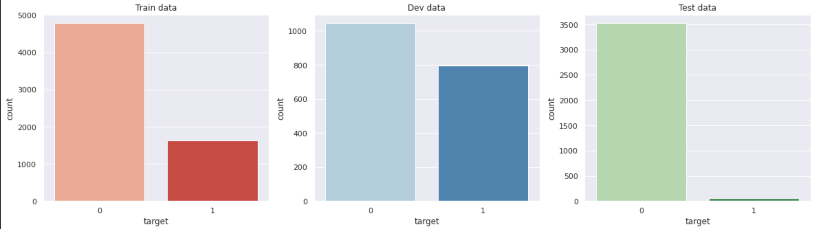
Approach: Model Training
I minimized the dataset to 12 patients
66%
Training
33%
Validation
33%
Test

Slide 9
Results
79% Accuracy on Training set
87% Accuracy on Test set
87% Accuracy on Validation set

Slide 10
Demo

Slide 11

Next Iteration
$$f1=\frac{2}{\frac{1}{recall}+\frac{1}{precision}}$$
Use a better evaluation metric
Edit data set to be balanced
Develop a React simple app query the API
Improve the model

